Slide 1
Exceptions and Interrupts

Slide 2
Overview
What Are Exceptions and Interrupts?
Exception Types on the Cortex-M0 Processor
Exception Priority Definition
Vector Table
Exception Sequence Overview
Exception Entry Sequence
Exception Exit Sequence

Slide 3
What Are Exceptions and Interrupts?
Exceptions are events that cause changes in program flow control outside a normal code sequence.
When it happens, the program that is currently executing is suspended, and a piece of code associated with the event (the exception handler) is executed.
The events could either be external or internal. When an event is from an external source, it is commonly known as an interrupt or interrupt request (IRQ).

Slide 4
Exceptions and Interrupts
The software code that is executed when an exception occurs is called exception handler.
If the exception handler is associated with an interrupt event, then it can also be called an interrupt handler, or interrupt service routine (ISR).
The exception handlers are part of the program codein the compiled program image.

Slide 5
Exceptions and Interrupts
When the exception handler has finished processing the exception, it will return to the interrupted program and resume the original task.
As a result, the exception handling sequence requires some way to store the status of the interrupted program and allow this information to be restored after the exception handler has completed its task.
This can be done by a hardware mechanism or by a combination of hardware and software operations.

Slide 6
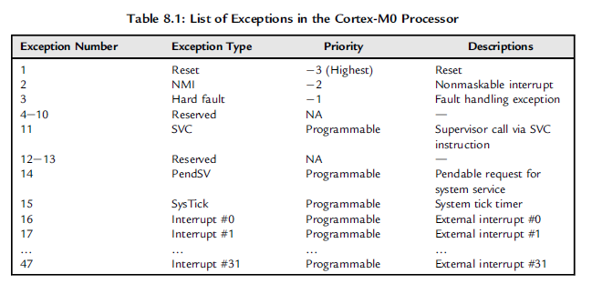
Exception Types on the Cortex-M0 Processor

Slide 7
Exception Types on the Cortex-M0 Processor
Nonmaskable Interrupt (NMI)
The NMI is similar to IRQ, but it cannot be disabled and has the highest priority apart from the reset.
It is very useful for safety critical systems like industrial control or automotive.
Depending on the design of the microcontroller, the NMI could be used for power failure handling, or it can be connected to a watchdog unit to restart a system if the system stopped responding.
Because the NMI cannot be disabled by control registers, the responsiveness is guaranteed.

Slide 8
Exception Types on the Cortex-M0 Processor
Hard Fault
Hard fault is an exception type dedicated to handling fault conditions during program execution.
These fault conditions can be trying to execute an unknown opcode, a fault on a bus interface or memory system, or illegal operations like trying to switch to ARM state.

Slide 9
Exception Types on the Cortex-M0 Processor
SVCall (SuperVisor Call)
SVC exception takes place when the SVC instruction is executed. SVC is usually used in systems with an operating system (OS), allowing applications to have access to system services.
PendSV (Pendable Service Call)
PendSV is another exception for applications with OS. Unlike the SVC exception, which must start immediately after the SVC instruction has been executed, PendSV can be delayed.
The OS commonly uses PendSV to schedule system operations to be carried out only when high-priority tasks are completed.

Slide 10
Exception Types on the Cortex-M0 Processor
SysTick
The System Tick Timer inside the NVIC is another feature for OS application.
Almost all operating systems need a timer to generate regular interrupt for system maintenance work like context switching.
By integrating a simple timer in the Cortex-M0 processor, porting an OS from one device to another is much easier.
The SysTick timer and its exception are optional in the Cortex-M0 microcontroller implementation.
Interrupts
The Cortex-M0 microcontroller could support from 1 to 32 interrupts. The interrupt signals could be connected from on-chip peripherals or from an external source via the I/O port.
In some cases (depending on the microcontroller design), the external interrupt number might not match the interrupt number on the Cortex-M0 processor.

Slide 11
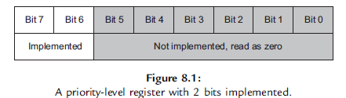
Exception Priority Definition
In the Cortex-M0 processor, each exception has a priority level. The priority level affects whether the exception will be carried out or if it will wait until later (stay in a pending state).
The Cortex-M0 processor supports three fixed highest priority levels and four programmable levels. For exceptions with programmable priority levels, the priority level configuration registers are 8 bits wide, but only the two MSBs are implemented

Slide 12
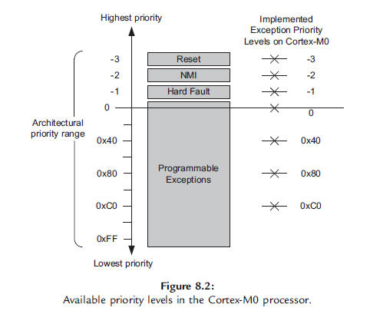
Exception Priority Definition

Slide 13
Vector Table
When the Cortex-M0 processor starts to process an interrupt request, it needs to locate the starting address of the exception handler.
This information is stored in the beginning of the memory space, called the vector table
The order of exception vector being stored is the same order of the exception number.
Because each vector is one word (four bytes), the address of the exception vector is the exception number times four.
Each exception vector is the starting address of the exception handler, with the LSB set to 1 to indicate that the exception handler is in Thumb code.

Slide 14
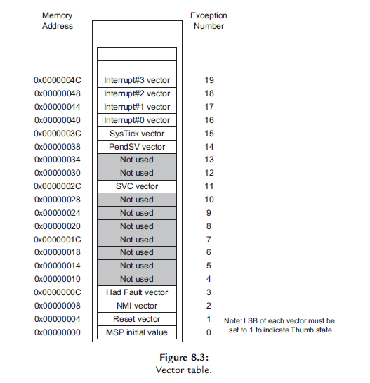
Vector Table

Slide 15
Exception Sequence Overview
Acceptance of Exception Request
The processor accepts an exception if the following condition are satisfied
For interrupt and SysTick interrupt requests, the interrupt has to be enabled
The processor is not running an exception handler of the same or a higher priority
The exception is not blocked by the PRIMASK interrupt masking register

Slide 16
Exception Sequence Overview
Stacking and Unstacking
Tail Chaining
Late Arrival

Slide 17
Stacking and Unstacking
To allow an interrupted program to be resumed correctly, some parts of the current state of the processor must be saved before the program execution switches to the exception handler that services the occurred exception.
When an exception is accepted on the Cortex-M0 processor, some of the registers in the register banks (R0 to R3, R12, R14), the return address (PC), and the Program Status Register (xPSR) are pushed to the current active stack memory automatically.
The Link Register (LR/R14) is then updated to a special value to be used during exception return (EXC_RETURN),and then the exception vector is automatically located and the exception handler starts to execute.

Slide 18
Stacking and Unstacking
At the end of the exception handling process, the exception handler executes a return using the special value (EXC_RETURN, previously generated in LR) to trigger the exception return mechanism.
The actions of automatically saving and restoring of the register contents are called “stacking” and “unstacking”

Slide 19
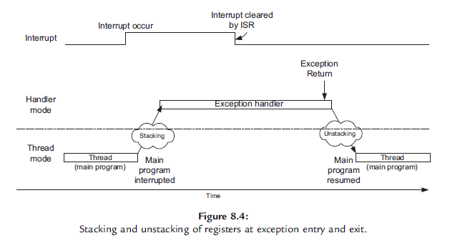
Stacking and Unstacking

Slide 20
Tail Chaining
If an exception is in a pending state when another exception handler has been completed, instead of returning to the interrupted program and then entering the exception sequence again, a tail-chain scenario will occur.
When tail chain occurs, the processor will not have to restore all register values from the stack and push them back to the stack again. The tail chaining of exceptions allows lower exception processing overhead and hence better energy efficiency

Slide 21
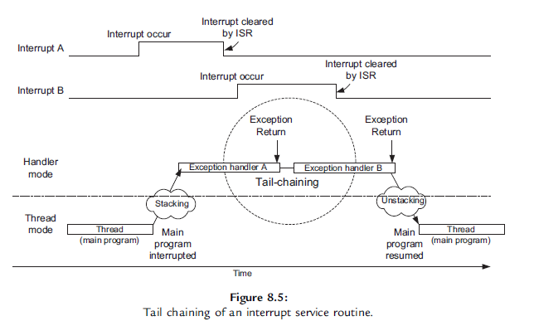
Tail Chaining

Slide 22
Late Arrival
Late arrival is an optimization mechanism in the Cortex-M0 to speed up the processing of higher priority exceptions. If a higher priority exception occurs during the stacking process of a lower priority exception, the processor switches to handle the higher-priority exception first (Figure 8.6).
At the end of the stacking process, the vector for the higher-priority exception is fetched instead of the lower-priority one. Without the late arrival optimization, a processor will have to preempt and enter the exception entry sequence again at the beginning of the lower-priority exception handler. This results in longer latency as well as larger stack memory usage.

Slide 23
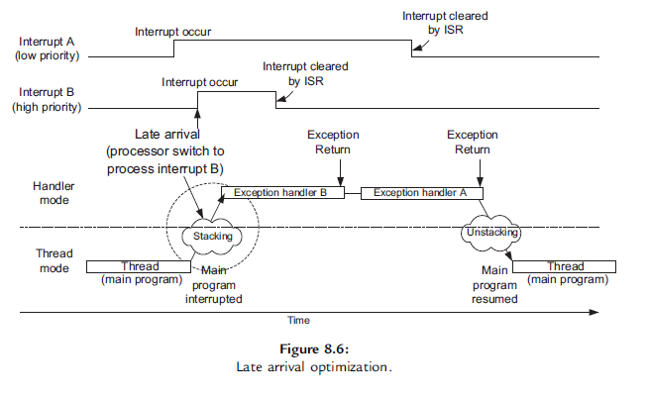
Late Arrival

Slide 24
EXC_RETURN
The EXC_RETURN is a special architecturally defined value for triggering and helping the exception return mechanism.
This value is generated automatically when an exception is accepted and is stored into the Link Register (LR, or R14) after stacking.
The EXC_RETURN is a 32-bit value; the upper 28 bits are all set to 1, and bits 0 to 3 are used to provide information for the exception return mechanism

Slide 25
EXC_RETURN
Bit 0 of EXC_RETURN on the Cortex-M0 processor is reserved and must be 1.
Bit 2 of EXC_RETURN indicates whether the unstacking should restore registers from the main stack (using MSP) or process stack (using PSP).
Bit 3 of EXC_RETURN indicates whether the processor is returning to Thread mode or Handler mode.

Slide 26
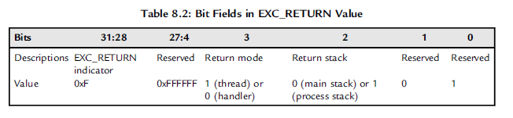
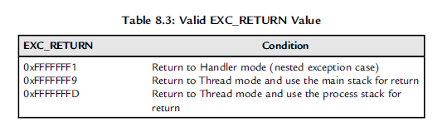
EXC_RETURN

Slide 27
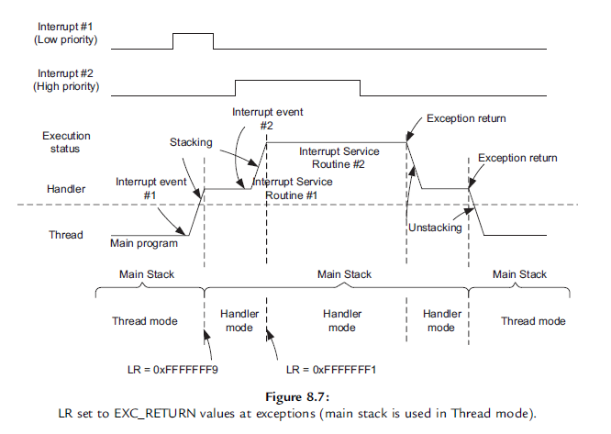
EXC_RETURN
If the thread is using main stack (CONTROL register bit 1 is zero), the value of the LR will be set to 0xFFFFFFF9 when it enters an exception and 0xFFFFFFF1 when a nested exception is entered, as shown in Figure

Slide 28
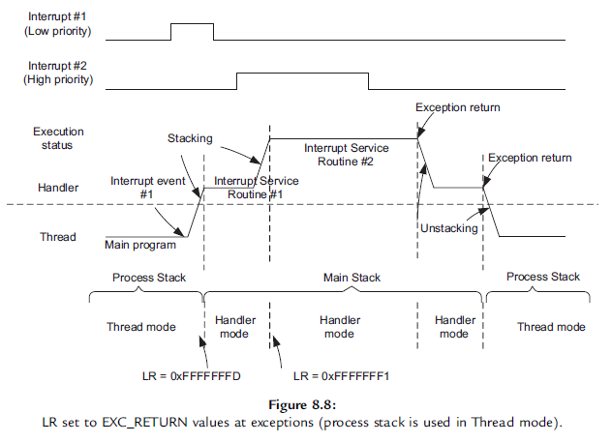
EXC_RETURN
If the thread is using process stack (CONTROL register bit 1 is set to 1), the value of LR will be 0xFFFFFFFD when entering the first exception and 0xFFFFFFF1 when entering a nested exception, as shown in Figure

Slide 29
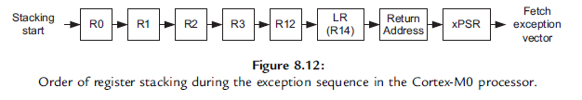
Exception Entry Sequence
The stacking of registers is carried out in the order shown in

Slide 30
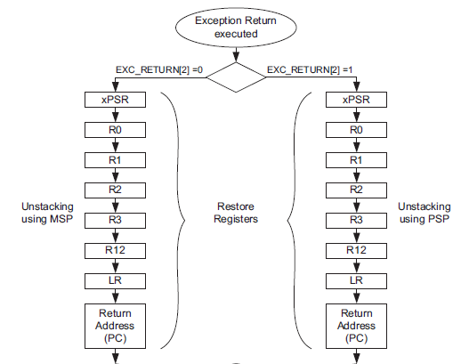
Exception Exit Sequence

Slide 31
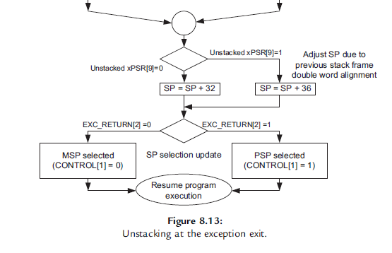
Exception Exit Sequence

Slide 32
Questions?

